Slide 1
Fruiting Vegetables

Slide 2



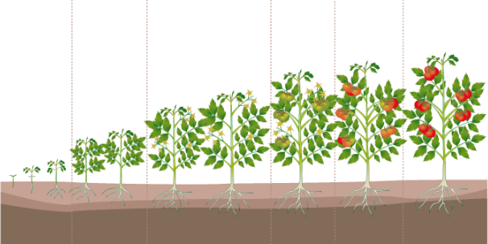
Certis Integrated Copper Solution:
Fruiting vegetables
Organic Program
+
Conventional Program
Less stress on small plants
4hr REI
Less residue

Slide 3
Bacterial Spot Control-Tomato
Pacific Tomato, Immokalee, FL
8 applications
IND-2010-078

Slide 4
Bacterial Spot Control -Tomato
Disease Severity (%)
Dr. Roberts, University of Florida, Immokalee, FL - 2009
5 applications

Slide 5
Bacterial Spot Control-Tomato
Cueva 2qt
+ Double Nickel 0.5lb
Kocide 3000 1.75lb
+ Manzate ProStik 2lb
UTC
Dr. Roberts, University of Florida, Immokalee, FL - 2010
11 applications

Slide 6
Bacterial Spot Control-Tomato
Dr. Roberts, University of Florida, Immokalee, FL - 2010
11 applications

Slide 7
Bacterial Spot Control-Pepper
Cueva 2qt
+ Double Nickel 0.5lb
Kocide 3000 1.25lb
+ Manzate ProStik 2lb
UTC
Dr. Langston, University of Georgia, Tifton, GA - 2011
5 applications

Slide 8
Bacterial Speck Control-Tomato
% Disease Incidence
Trial 1
Trial 2
a
a
b
b
Cueva 0.5% v/v
+ Double Nickel 0.5lb
Untreated
Cueva 0.5% v/v
+ Double Nickel 0.5lb
Untreated
Under extreme conditions with artificial inoculation, Cueva + Double Nickel combination resulted in an average 62% control
Mike Davis, University of California – 2010
Treatments applied 1 day before and 7 days after inoculation
Notes:
These lab trials promoted extreme pressure on the compounds to perform. 60% control of this pathogen is extremely good

Slide 9
Bacterial Speck Control-Tomato
a
a
a
b
b
b
Pacific Agricultural Research, CA - 2014
5 applications on 14 day interval

Slide 10
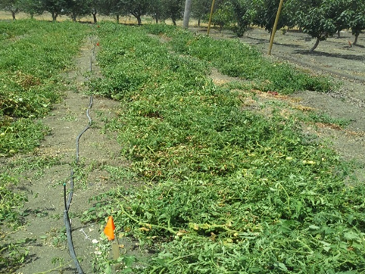
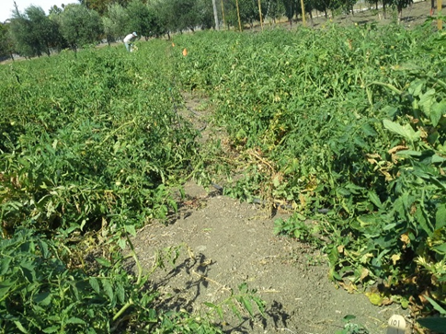
Bacterial Speck Control-Tomato
Untreated Plot
Cueva Plot
Pacific Agricultural Research, CA - 2014
5 applications on 14 day interval
CER-2014-016

Slide 11
Early Blight Control-Tomato
a
ab
b
Cueva
2qt/100 gal
Serenade MAX
3 lb
UTC
Dr. Lange, Cornell University - 2012
6 applications
IND-2012-133

Slide 12
Fruiting Vegetable Positioning
Copper | Signal Word | REI (hours) | PPE Early Entry | pH | OMRI | Inhalation Warning | Minimum Retreat Interval (days)
Cueva | CAUTION | 4 | Rubber gloves | 7.0 | YES | NO | 3
Kocide 2000 | WARNING | 48 | Eyewear + rubber gloves | 8.6 | NO | YES | 3
Kocide 3000 | CAUTION | 48 | Rubber gloves | 7.5-9.5 | NO | YES | 3
Champ Dry Prill | WARNING | 48 | Eyewear + rubber gloves | 10.4 | NO | YES | 3
Champ WG | DANGER | 48 | Eyewear + rubber gloves | 8.0-9.0 | YES | YES | 3
Nu-Cop 50WP | DANGER | 48 | Eyewear + rubber gloves | 7.0 | NO | YES | 3
Badge X2 | WARNING | 48 | Eyewear + rubber gloves | 7.7 | YES | YES | 3
Badge SC | CAUTION | 48 | Eyewear + rubber gloves | 6.0-8.0 | NO | NO | 3
Cuprofix Ultra 40 | CAUTION | 48 | Eyewear + rubber gloves | 7.0 | NO | YES | 3
Nordox | CAUTION | 12 | Rubber gloves | 8.5 | YES | NO | 3
C-O-C-S | WARNING | 48 | Eyewear + rubber gloves | ? | NO | NO | 3
MasterCop | DANGER | 48 | Eyewear + rubber gloves | 4.5-5.5 | NO | YES | 3
CS2005 | DANGER | 48 | Eyewear + rubber gloves | 2.0 | YES | YES | 5

Slide 13
Cucurbits

Slide 14
Powdery Mildew Control-Squash
a
b
Very good control under heavy disease pressure
Florida Ag Research, FL - 2010
Notes:
Cueva and DN both have good activity on PM. Combine them for strong protection under heavy disease pressure.

Slide 15
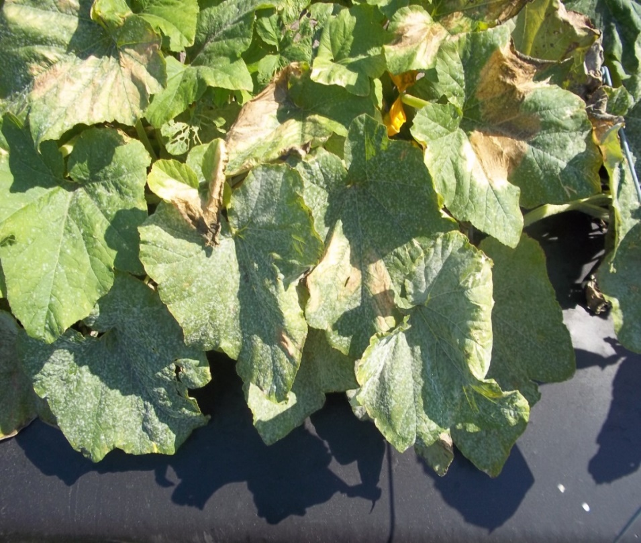
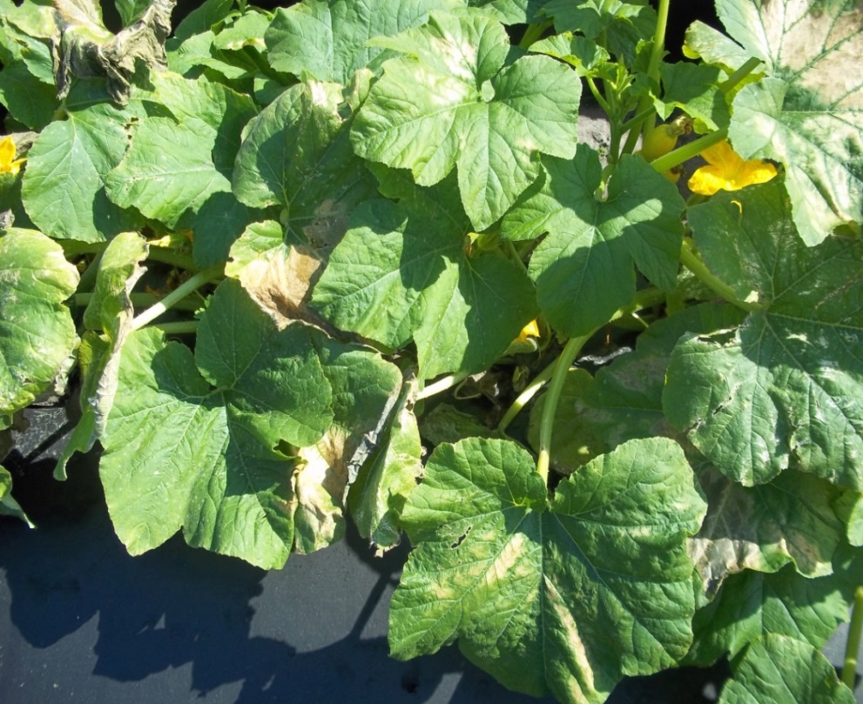
Powdery Mildew Control-Squash
Untreated
Cueva 2qt + Double Nickel 0.5lb
Very good control under heavy disease pressure
Florida Ag Research, FL - 2010
CER-2010-142
Notes:
Cueva and DN both have good activity on PM. Combine them for strong protection under heavy disease pressure.

Slide 16
Downy Mildew Control-Cucumber
ab
ab
c
Cueva
2qt/100 gal
Sonata
4 qt
UTC
Dr. Lange, Cornell University - 2012
4 applications
IND-2012-134
Notes:
Copper does have activity on downy mildew and you don’t have to worry about Cueva causing phyto like other coppers

Slide 17
Bacterial Leaf Spot-Pumpkins
Mohammed Babadoost, Urbana, IL. Low BLS severity, 8 applications, 7 day intervals. . Means with same letters NSD at 0.05 level.

Slide 18
Bacterial Leaf Spot-Pumpkins
Mohammed Babadoost, Urbana, IL. Low BLS severity, 8 applications, 7 day intervals. . Means with same letters NSD at 0.05 level.

